Slide 1

Network Coverage
Presented By:-
Priyanka. B. Patil:- U15BL23S0090
Sakshi .M . Badmanji :- U15BL23S0103

Slide 2
Introduction
Network coverage refers to the geographical area where a network service provider's services are available. For example, a mobile network operator's network coverage is the area where their subscribers can access and use their data services.

Slide 3
Network Coverage are classified into four geographical areas :-
Personal Area Network (PAN)
Local Area Network (LAN)
Metropolitan Area Network (MAN)
Wide Area Network (WAN)

Slide 4
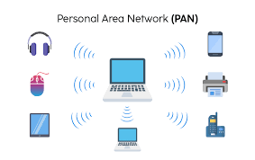
Personal Area Network (PAN)
A personal area network (PAN) is a network that connects electronic devices within a person's immediate area, usually within a few meters. PANs can be wired or wireless, and can include devices like computers, smartphones, tablets, printers, and more.

Slide 5
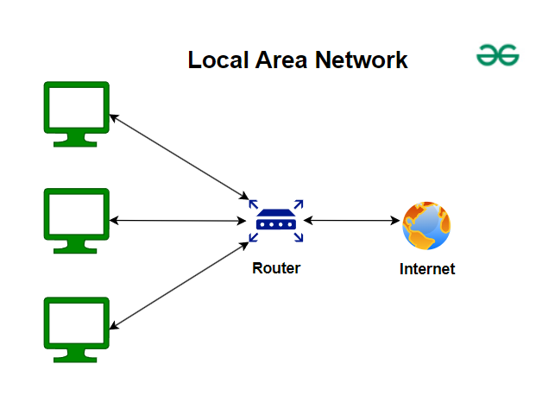
Local Area Network (LAN)
A Local Area Network (LAN) is a collection of devices that are connected in a single physical location, such as a home, office, or school. LANs can be small or large, ranging from a home network to a large enterprise network

Slide 6
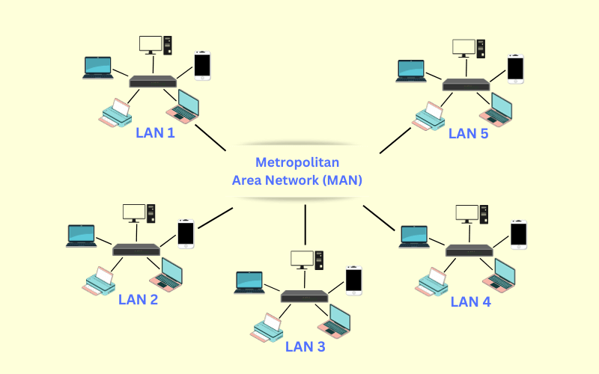
Metropolitan Area Network (MAN)
A metropolitan area network (MAN) is a computer network that is larger than a single building local area network (LAN) but is located in a single geographic area that is smaller than a wide area network (WAN). Generally, it is several LANs interconnected by dedicated backbone connections.

Slide 7
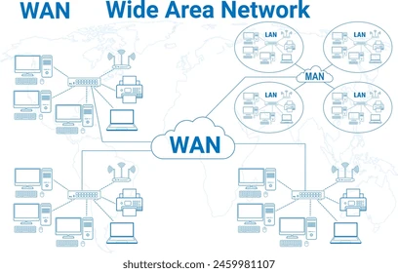
Wide Area Network (WAN)
A wide-area network (WAN) is the technology that connects your offices, data centers, cloud applications, and cloud storage together. It is called a wide-area network because it spans beyond a single building or large campus to include multiple locations spread across a specific geographic area, or even the world.

Slide 8
Thank You…

